Slide 1
FrontEnds
Pravin Y Pawar

Slide 2
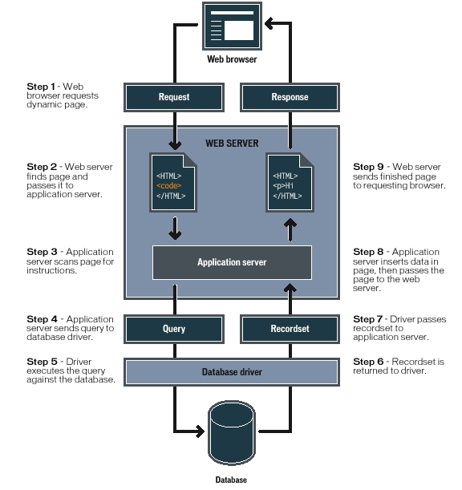
WebApps
Working
Image source

Slide 3
Front end and back end
the separation of concerns
In software engineering,
Front end refer to the presentation layer (front end),
Backend refer to the data access layer (back end) of a piece of software, or the physical infrastructure or hardware
In the client–server model,
the client is usually considered the front end
the server is usually considered the back end, even when some presentation work is actually done on the server itself.
A rule of thumb is that
the client-side (or "front end") is any component manipulated by the user
the server-side (or "back end") code usually resides on the server, often far remote from user

Slide 4
Front-end
Focus is on
User Interface elements
Mark-up and web languages such as HTML, CSS, JavaScript and supporting libraries
Asynchronous request handling and AJAX
Single-page applications (with frameworks like React, AngularJS or Vue.js)
Web performance
Responsive web design
Cross-browser compatibility issues and workarounds
End-to-end testing with a headless browser
Build automation to transform and bundle JavaScript files, reduce images size
Search engine optimization
Accessibility concerns

Slide 5
Back-end
Focus is on
Software Architecture
Application Business Logic
Application Data Access
Database management
Scripting languages like JavaScript, Node.js, PHP, Python, Ruby, Java etc.
Automated testing frameworks for the language being used
Scalability
High availability
Security concerns, authentication and authorization

Slide 6
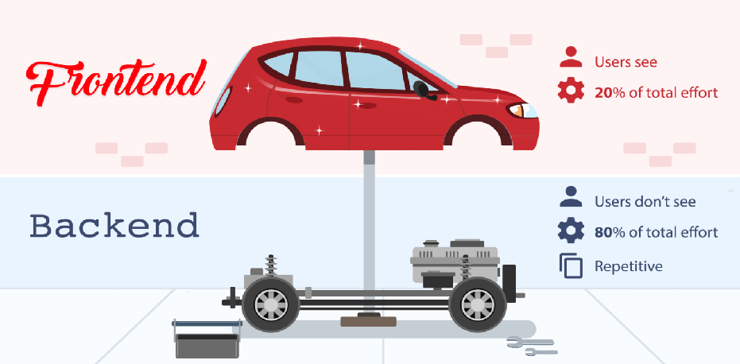
Front end – Back end
Image Source : Back4App

Slide 7
Thank You!
In our next session:

